Slide 1
MSE 311: Thermodynamics of Materials
Lecture 13: Regular solution
Weishu Liu
Department of Materials Science and Engineering
Southern University of Science and Technology (SUSTech)
Email: liuws@sustech.edu.cn
Office: North Tower, Rm310

Slide 2
31. The behavior of non idea solutions
Ref. Introduction of Thermodynamics of Materials, D. R. Gaskell, Chapter 9

Slide 3
Non-idea solution
Raoult’s law
A Raoultian ideal solution
Henry’s law
A non-ideal solution is one in which the activities of the components are not equal to their mole fractions
For simple,
for idea solution
for nonidea solution
γ_{i} is activity coefficient
Both a_{i} and γ_{i} depend on concentration
is always less than one
is less than one for nagative deviation solution
is larger than one for positive deviation solution

Slide 4
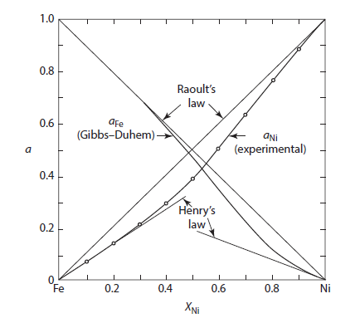
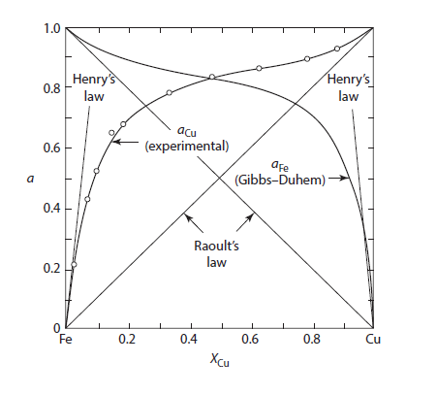

Determining TD activity coefficient
Negative deviation, γ<1
Positive deviation, γ>1
Figure 9.8 Activities in the system iron-nickel at 1600°C.
Figure 9.9 Activities in the system iron-copper at 1550°C
Gibbs-Duhem equation

Slide 5
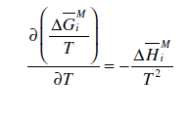
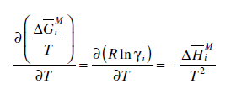

Nonidea solution
ideal solution
positive deviation from Raoultian behavior
negative deviation from Raoultian behavior
- Gibbs free energy
- The heat of mixing, if γ_{i} is temperature dependent
Gibbs-Helmholtz eq.

Slide 6
Nonidea solution
In general, increasing the temperature of a nonideal solution causes a decrease in the extent to which its components deviate from ideal behavior
For positive deviation
The mixing is endothermic
The A-B bonding is less negative than that of A-A and B-B
eg. Fe-Cu
For negetive deviation
eg. Fe-Ni
The mixing is exothermic
The A-B bonding is more negative than that of A-A and B-B

Slide 7
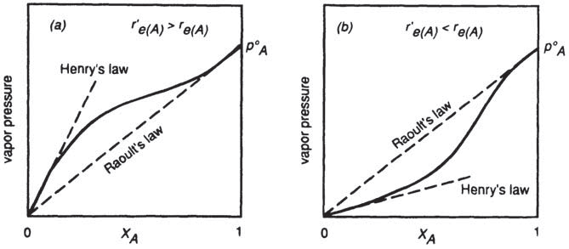
Henry’s law
(a): A-B bonding is weaker than A-A
A-B is less-negative than A-A
Positive deviation
from Raoultian behavior
(b): A-B bonding is stronger than A-A
A-B is less-negative than A-A
Negative deviation
from Raoultian behavior
For positive deviation
For negetive deviation
The mixing is endothermic
The mixing is exothermic

Slide 8

Enthalpy VS. Entropy
The enthalpy, being determined by the relative magnitudes of the bond energies, attempts to either completely order (negative deviation from ideality) or completely un-mix (positive deviation from ideality) the solution
The entropy factor attempts to maximize the randomness of mixing of the atoms in the solution

Slide 9
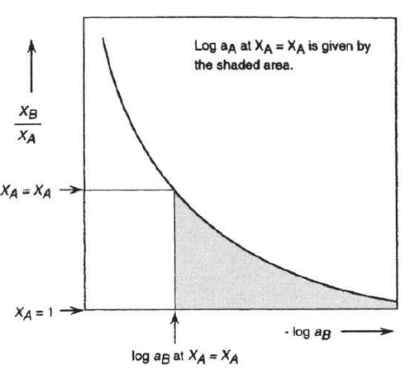



Determining TD activity
---application of Gibbs -Duhem
Two infinity tails
As X_{B} → 1, a_{B} → 1, and X_{B}/X_{A} → infinity
As X_{B} → 0, a_{B} → 0 and X_{B}/X_{A} → minus infinity

Slide 10
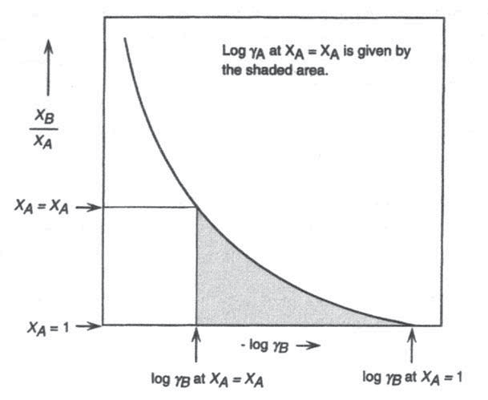
Determining TD activity coefficient
-The minus infinity can be dliminated by considering activity coefficient

Slide 11
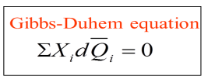
Relationship between Herry's and Raoult's laws
Consider solute B in A-B solution follows Herry's law:
The range of composition over which the solute B obeys Henry's law, the solvent A obeys Raoult's law

Slide 12
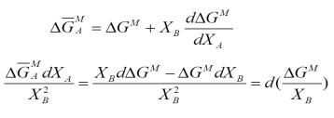
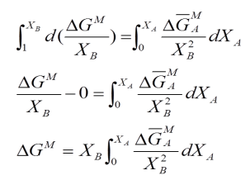
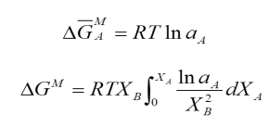
Direct Calculation of Integral Molar Gibbs Free Energy
Rearranging and dividing by X_{B}²
Integrating between X_{A}=0 and X_{A}=X_{B}
Can be applied to any state properties

Slide 13
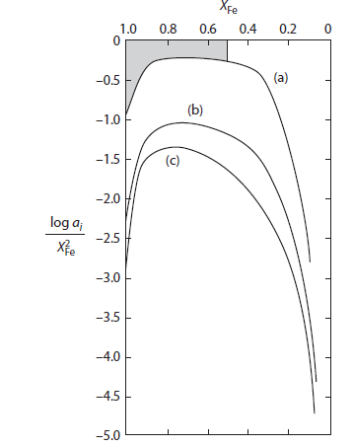


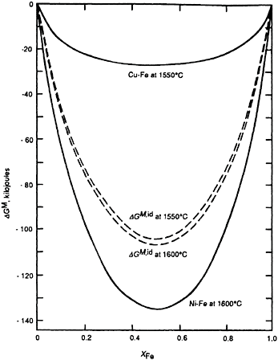
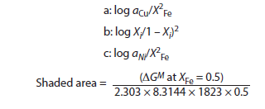
Calculation of ∆G from measured activity
Line a
Line c
(a)
(c)
Line b is the case for Raoults’s behavior

Slide 14
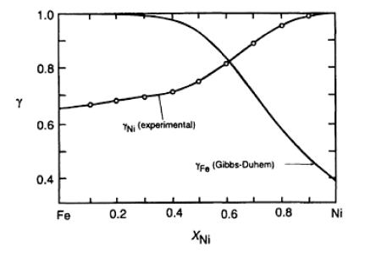
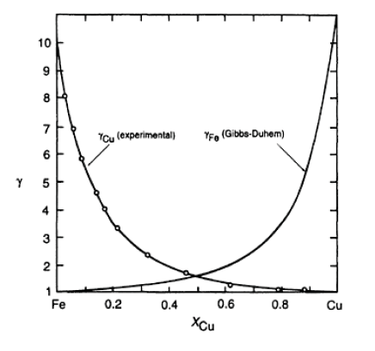
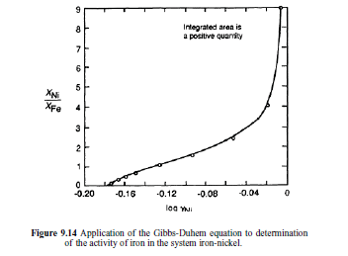
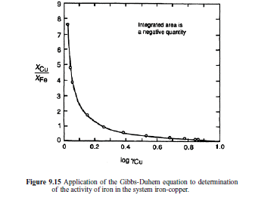
Determining TD activity coefficient

Slide 15
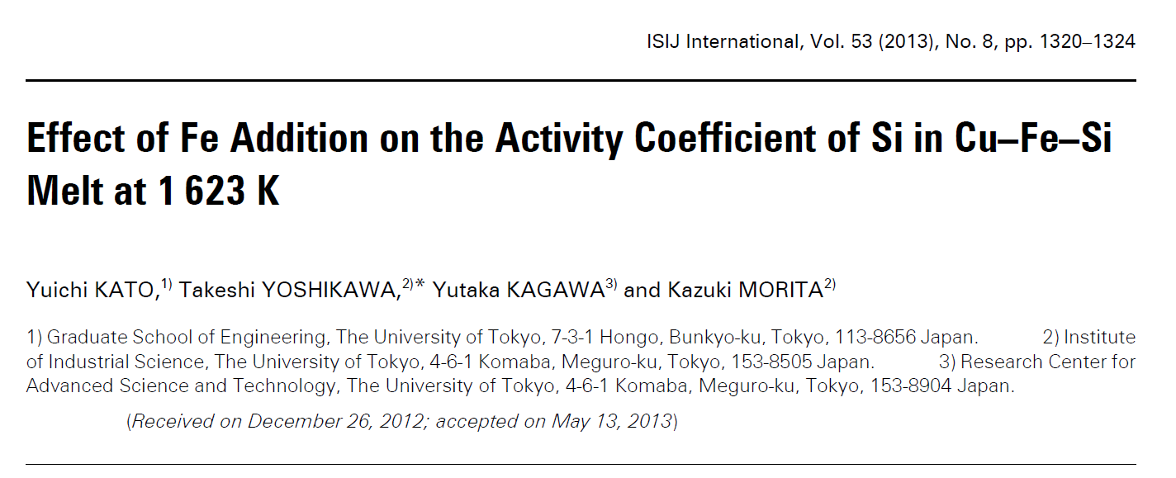
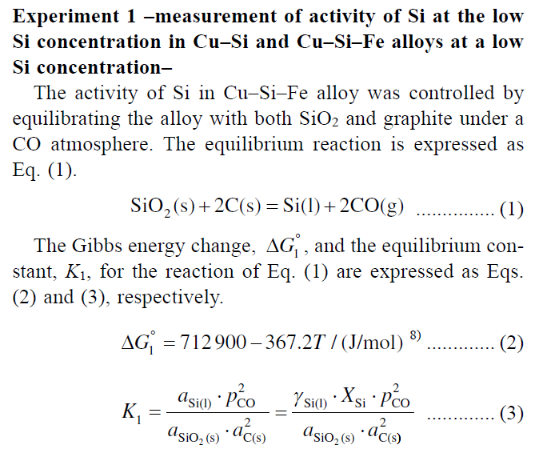
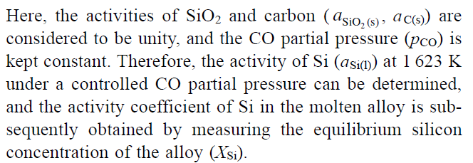
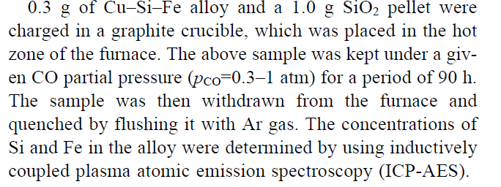

Slide 16
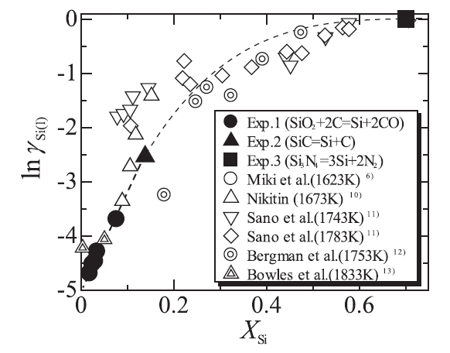
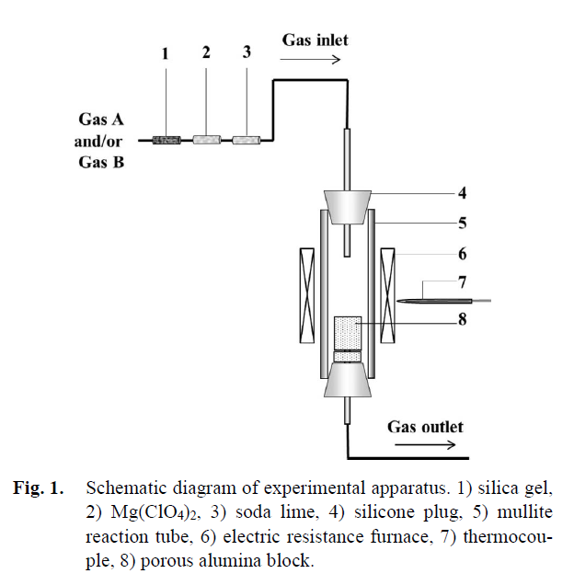
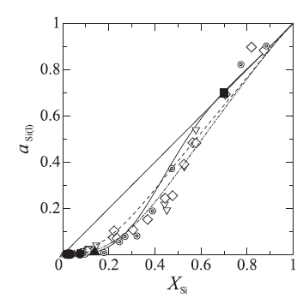
Measuring activity of Si in Si-Cu

Slide 17
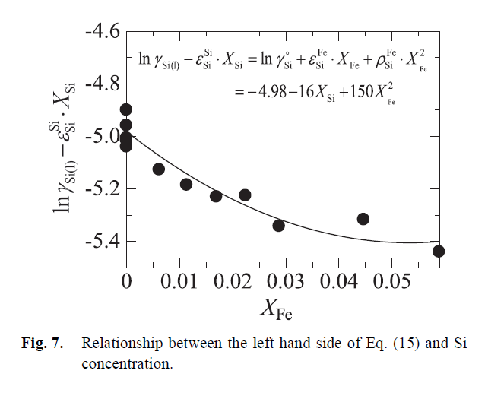

activity coefficient of Si in Cu-Si-Fe

Slide 18
32. The regular solutions
Ref. Introduction of Thermodynamics of Materials, D. R. Gaskell, Chapter 8

Slide 19
Regular solution
Thus far two classes of solution have been identified:
1. Ideal or Raoultian solutions in which
2. Nonideal solutions in which and
In 1895,Margules suggested that, at constant temperature, the activity coefficients of the components of a binary solution
Activity: a_{i}
activity coefficients : γ
Gibbs-Duhem equation:
We can demonstrate
For quadratic term alone
α i s T dependent

Slide 20
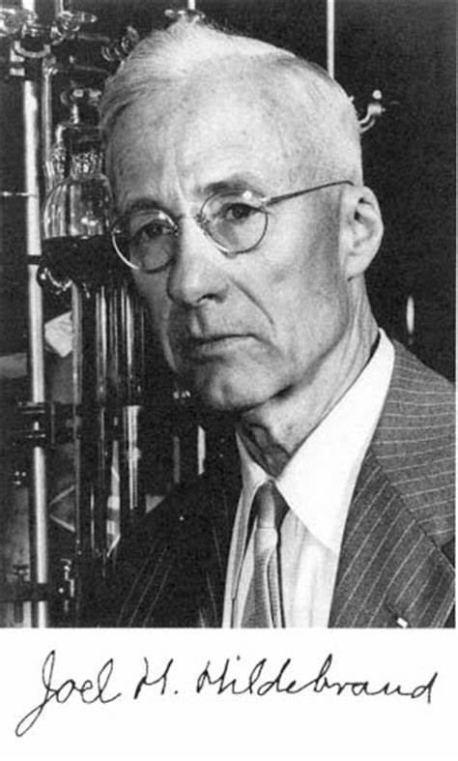
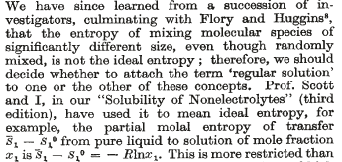

Regular solution
1949: Guggenheim, Rushbrooke, et al.
referenced the “regular solution” as
General nonideal solution
Regular solution
Ω_{AB}: interaction parameter
is composition and temperature independent
University of Pennsylvania
Joel Henry Hildebrand
(1881-1983)

Slide 21
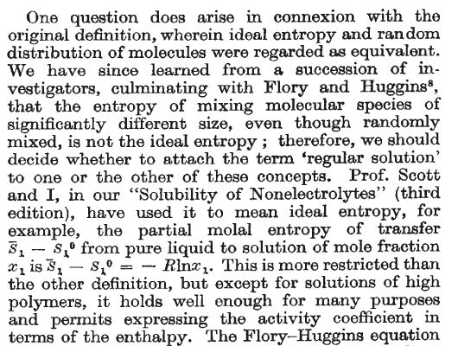
Regular solution
Hilderbrand claims the original definition of regular solution
“A solution has a idea mixing entropy”
activity coefficients
Regular solution

Slide 22
The change of enthalpy
of Regular solution
Nonidea solution
Idea solution:
Regular solution
Non-dea solution:
a; activity
γ: coefficient of activity
Ω: interaction parameter

Slide 23
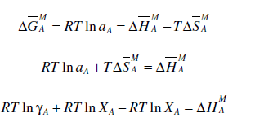
Regular solution
a; activity
γ: coefficient of activity
Ω: interaction parameter
As X_{A} → 1, γ_{A} → 1, A is a Raoultian solution
X_{B} → 0, γ_{B} → const., B is a Henrian solution
As X_{B} → 1, γ_{B} → 1, B is a Raoultian solution
X_{A} → 0, γ_{A} → const., A is a Henrian solution

Slide 24
33. The Statistic explanation of regular solutions
Ref. Introduction of Thermodynamics of Materials, D. R. Gaskell, Chapter 8

Slide 25

Statistics Model of Solutions
Bragg-William-Gorski (B-W-G model)
Important assumptions:
Nearest neighbor assumption: only the interaction between the nearest neighbors are considered
Random distribution: The atom A and B in the given lattice are totally random distribution:
Consider 1 mole of a mixed crystal
containing N_{A} atoms of A and N_{B} atoms of B
Three types of atomic bond in the crystal:
A-A bonds, the energy of each of which is E_{AA}
A-B bonds, the energy of each of which is E_{AB}
B-B bonds, the energy of each of which is E_{BB}

Slide 26

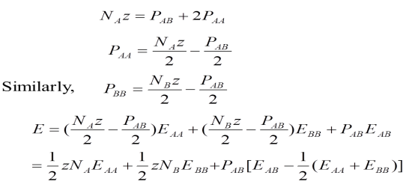
Statistics Model of Solutions
In the crystal, there are P_{AA} A-A bonds, P_{BB} B-B bonds are P_{AB} A-B bonds,the total energy of the crystal
Let's say each atom has z nearest neighbors,
total number of bond to A
The factor 2 arises because of each A-A bound involve two A atoms

Slide 27
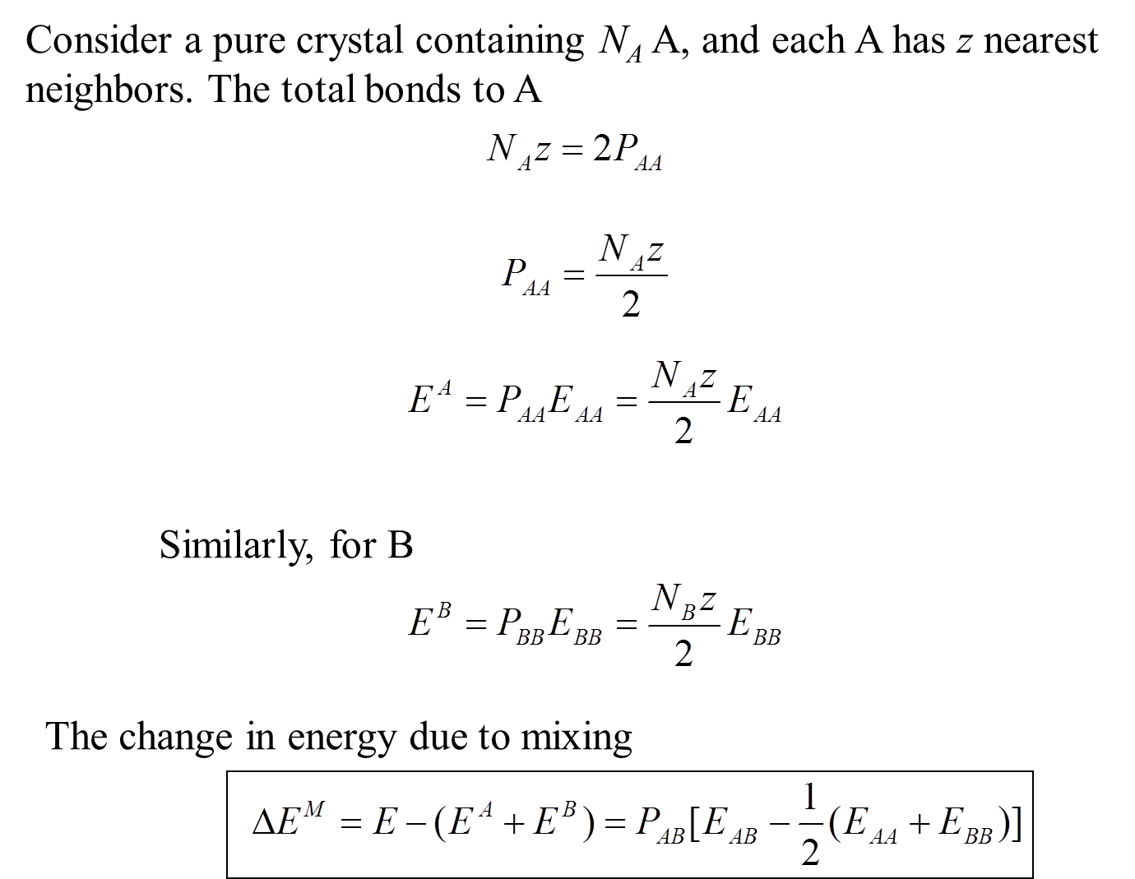
Statistics Model of Solutions
Consider a pure crystal containing N_{A} A, and each A has z nearest neighbors, The total bonds to A

Slide 28
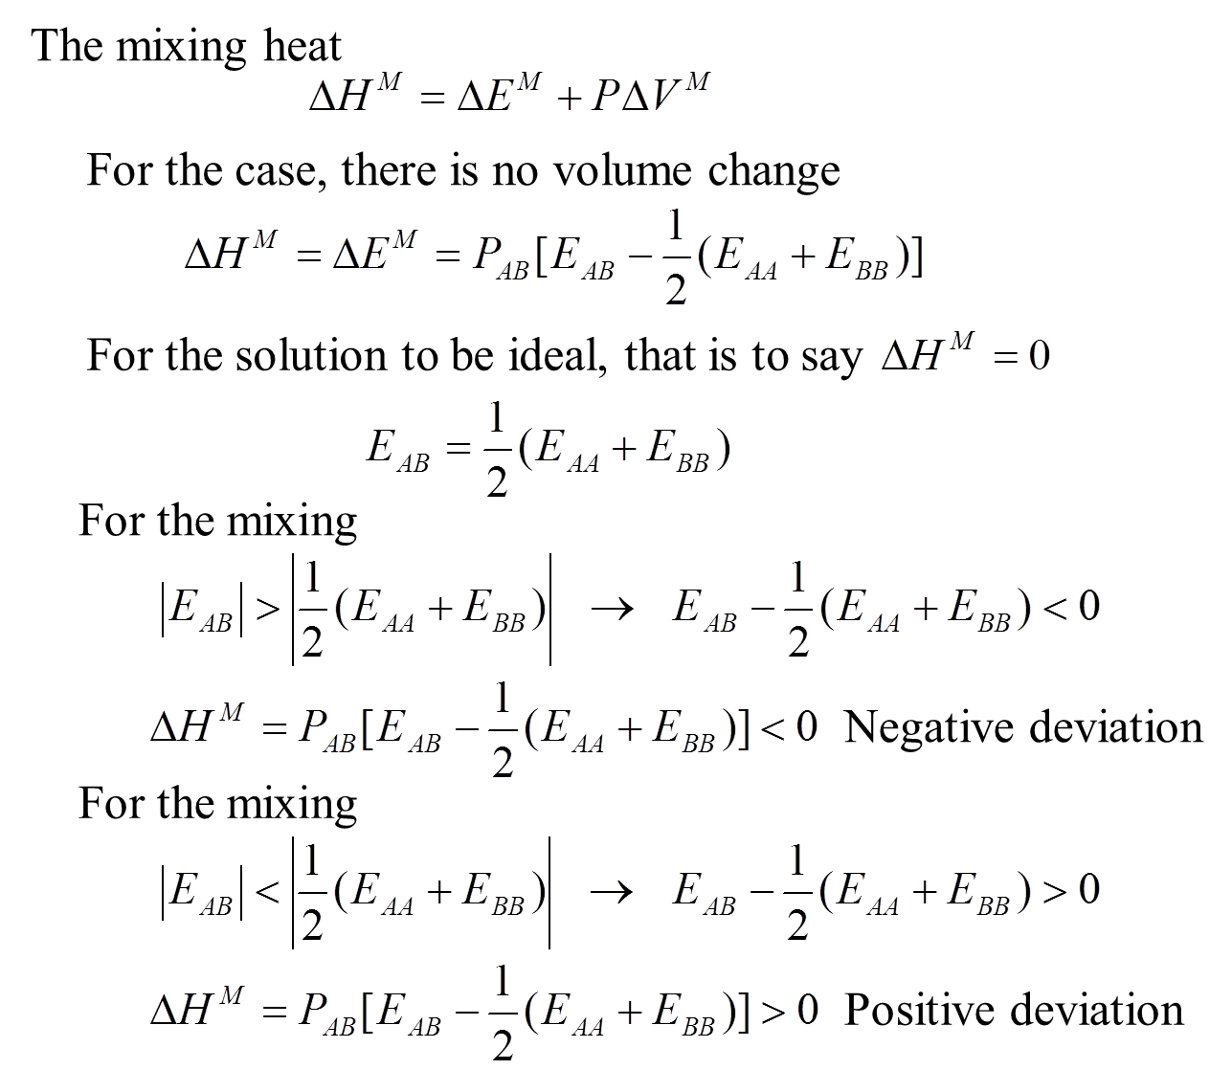
Statistics Model of Solutions
P: Pressure
Raoultian behavior
E
0
E_{AB}
Positive
deviation
(E_{AA +}E_{BB})/2
E_{AB}
Negative
deviation

Slide 29
Statistics Model of Solutions
If
In a solution which exhibits small deviations from ideal behavior
We can calculate P_{AB} as follows
Consider two sites in the crystal:1 and 2.
The probability of 1 is occupied by A is X_{A}.
Similarly, the probability of 2 occupied by B is X_{B}
So the probability of form A-B pair is 2X_{A}X_{B}
the probability of form A-A pair is X_{A}²
the probability of form B-B pair is X_{B}²

Slide 30




Statistics Model of Solutions
In a solution which exhibits small deviations from ideal behavior
There are 1/2zN_{o} pairs in 1mole of the crystal.
Z: the number of nearest neighbors, or coordination number

Slide 31
Statistics Model of Solutions
In a solution which exhibits small deviations from ideal behavior
activity coefficients
Regular solution

Slide 32
Statistics Model of Solutions
E
0
E_{AB}
Positive
deviation
(E_{AA +}E_{BB})/2
E_{AB}
Negative
deviation
Positive deviation
activity coefficients
Negative deviation
Regular solution

Slide 33
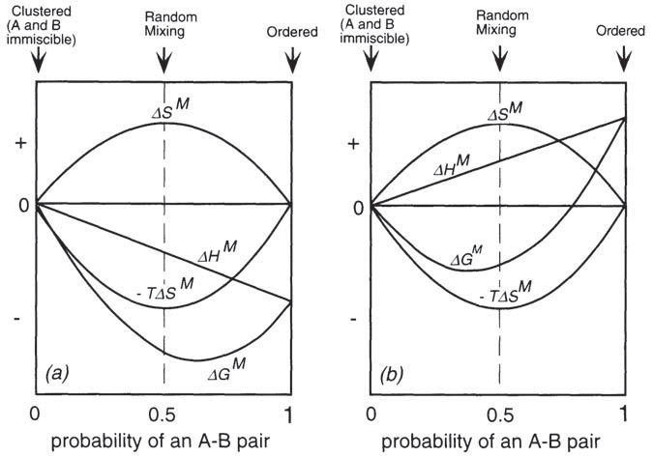
Statistics Model of Solutions
As the entropy contribution to the Gibbs free energy is dependent on temperature, then
For any value of Ω, more nearly random mixing occurs as the temperature is increased
For any given temperature, more nearly random mixing occurs with smaller values of Ω.
Figure 9.25 Illustration of the origins of deviation from regular solution behavior.

Slide 34
Mixing Entropy from Statistical model
The number of methods that randomly distribute N_{B} B atoms to N lattice nodes is
B atoms can not be distinguished and A atoms only fill lattice nodes without B atoms, so
The number of microscopic configurations before mixing considers only the same kind of atoms, hence
Stirling’s approximation: when X is very large: ln(N!) ≈ NlnN -N

